Slide 1
Segmentation
IVU Model Development Training Course
June 2014
1
Notes:
1

Slide 2
Agenda
Scorecard development process
Model development process @ nab
Choose the performance window
Choose the sample window
Sample exclusions
Design the good bad definition
Segmentation

Slide 3
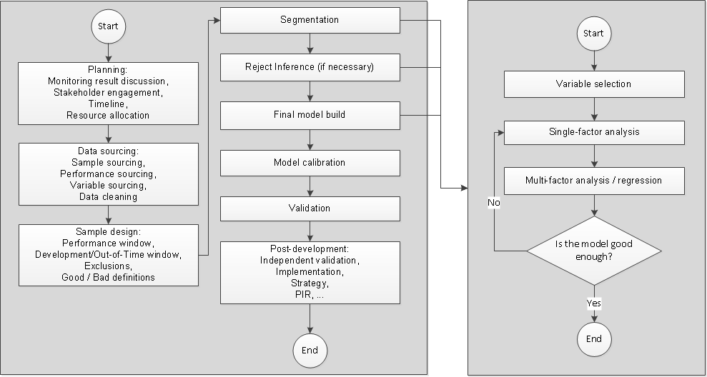
Scorecard development process
Full process
Modelling process

Slide 4
Segmentation
In some cases, instead of using one model on the entire population, several models are built on sub-populations. The split of the entire population is called segmentation
Main driver factors to segmentation:
Business requirement: different risk appetite thus different strategies and cut-offs. E.g., split by products
Different data is available. E.g., primary vs. non-primary
Different treatments. E.g., current clean vs. current dirty
Different risk signals / better model fit. E.g., young vs. old

Slide 5
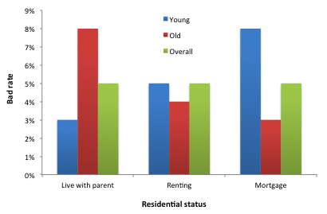
Segmentation
In some cases, instead of using one model on the entire population, several models are built on sub-populations. The split of the entire population is called segmentation
Main driver factors to segmentation:
Business requirement: different risk appetite thus different strategies and cut-offs. E.g., split by products
Different data is available. E.g., primary vs. non-primary
Different treatments. E.g., current clean vs. current dirty
Different risk signals / better model fit. E.g., young vs. old

Slide 6
Segmentation
In some cases, instead of using one model on the entire population, several models are built on sub-populations. The split of the entire population is called segmentation
Main driver factors to segmentation:
Business requirement: different risk appetite thus different strategies and cut-offs. E.g., split by products
Different data is available. E.g., primary vs. non-primary
Different treatments. E.g., current clean vs. current dirty
Different risk signals / better model fit. E.g., young vs. old
Overall, “residential status” is not a predictive variable

Slide 7
Segmentation
In some cases, instead of using one model on the entire population, several models are built on sub-populations. The split of the entire population is called segmentation
Main driver factors to segmentation:
Business requirement: different risk appetite thus different strategies and cut-offs. E.g., split by products
Different data is available. E.g., primary vs. non-primary
Different treatments. E.g., current clean vs. current dirty
Different risk signals / better model fit. E.g., young vs. old
Overall, “residential status” is not a predictive variable
On young segment, “Living with parent” has lowest risk and “On mortgage” has the highest risk

Slide 8
Segmentation
In some cases, instead of using one model on the entire population, several models are built on sub-populations. The split of the entire population is called segmentation
Main driver factors to segmentation:
Business requirement: different risk appetite thus different strategies and cut-offs. E.g., split by products
Different data is available. E.g., primary vs. non-primary
Different treatments. E.g., current clean vs. current dirty
Different risk signals / better model fit. E.g., young vs. old
Overall, “residential status” is not a predictive variable
On young segment, “Living with parent” has lowest risk and “On mortgage” has the highest risk
On old segment, the risk signal is completely reversed

Slide 9
How to choose splitting criteria
Manual selection (with the help of business knowledge)
Clustering analysis
Chi-square automatic interaction (CHAID) analysis
Quick & dirty model fit: quantify the most beneficial split

Slide 10
Good segmentation split
Have enough goods and bads to ensure statistical significant models
Population split is stable over time (Check monthly volumes)
Help the business to design different risk appetites for different sub-populations
Have significant meaningful performance up-lift (Attention: Gini may not be sufficient to decide which split produces more benefit!)
Put a chart here!

